Slide 1


CS-2001 Data Structures Fall 2022 Introduction to Tree
Mr. Muhammad Usman Joyia
National University of Computer and Emerging Sciences,
Faisalabad, Pakistan.

Slide 2
Trees
Hierarchical data structure
Finite collection of Items, stored in hierarchal fashion
A connected acyclic graph
Examples:
ToC in a book has a tree structure
A family tree
Organizational-positions tree
Others?
Notes:
Pstree, xml, PDF, chess, Facebook, databases, company hierarchy, decision trees

Slide 3
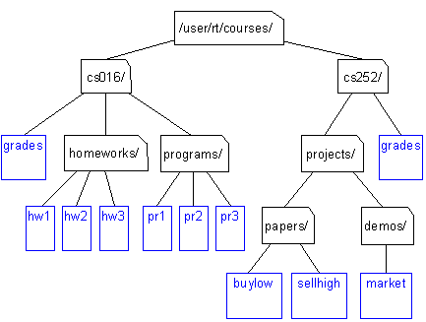
Unix / Windows file structure tree

Slide 4
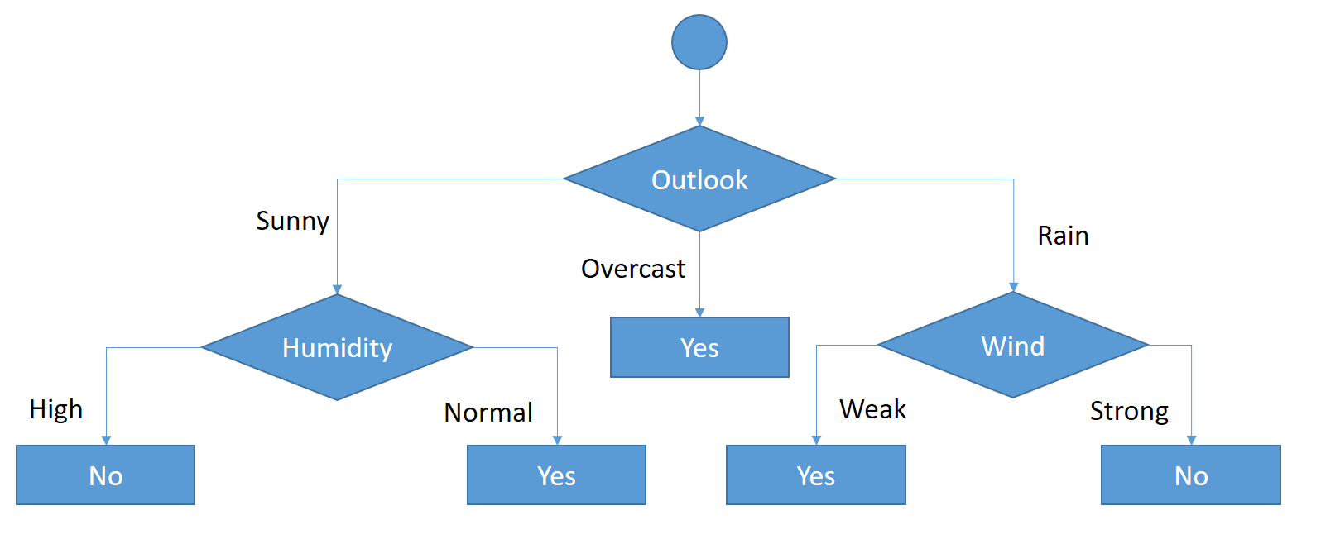
Decision Tree in AI
Notes:
Golf

Slide 5
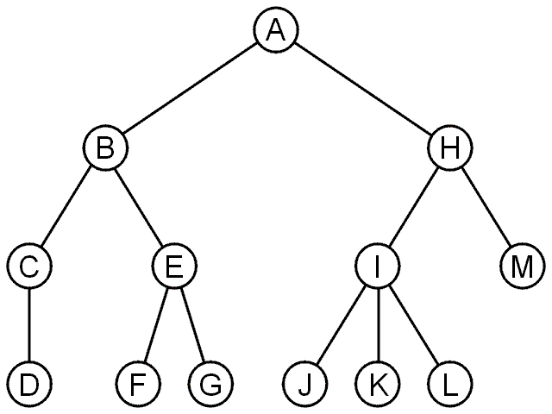
Trees
A rooted tree data structure stores information in nodes
Similar to lists:
There is a first node, or root
Each node has variable number of references or links to successors
Each node, other than the root, has exactly one node pointing to it

Slide 6
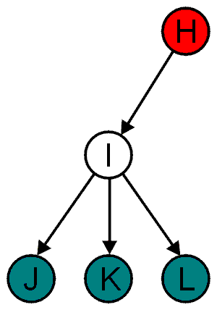
Terminology: Parent Child Relations
All nodes can have zero or more child nodes or children
I has three children: J, K and L
For all nodes other than the root node, there is one parent node
H is the parent I

Slide 7
Terminology: Degree
The degree of a node is defined as the number of its children
deg(I) = 3
Nodes with the same parent are siblings
J, K, and L are siblings

Slide 8
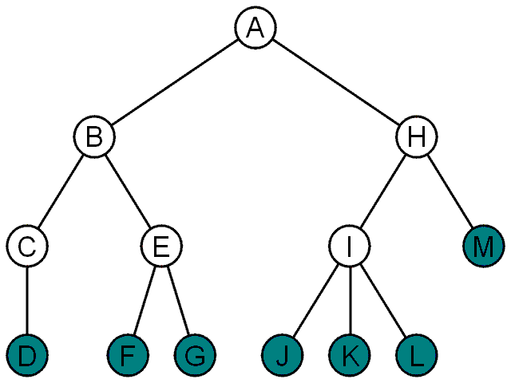
Terminology: Leaf And Internal Nodes
Nodes with degree zero are also called leaf nodes
All other nodes are said to be internal nodes, that is, they are internal to the tree

Slide 9
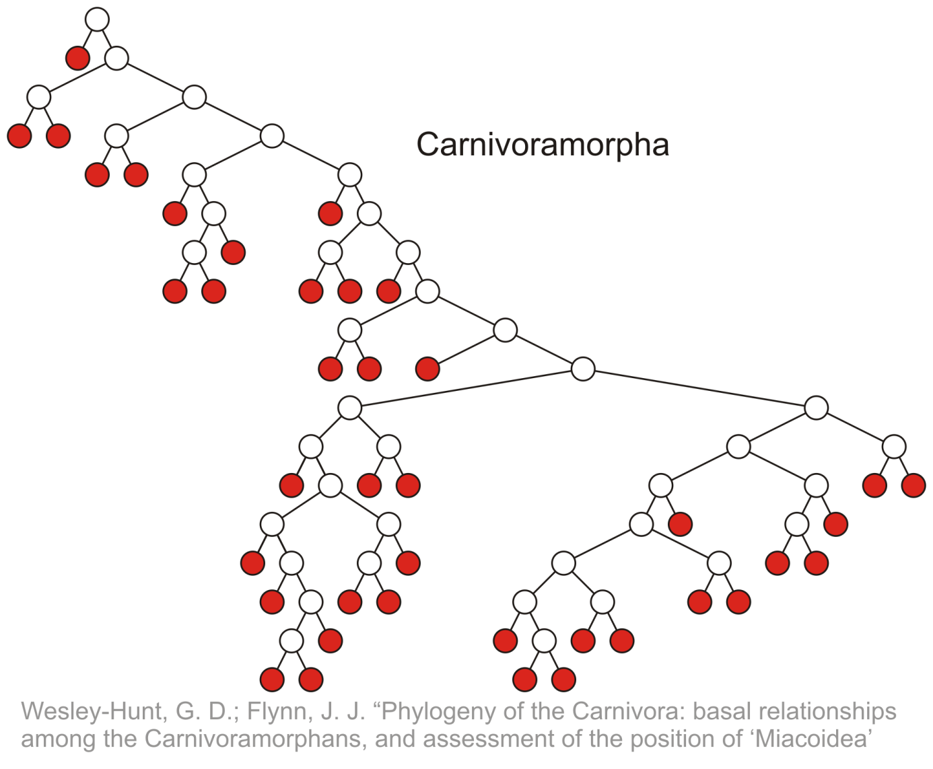
Terminology: Leaf Nodes Examples
Leaf nodes

Slide 10
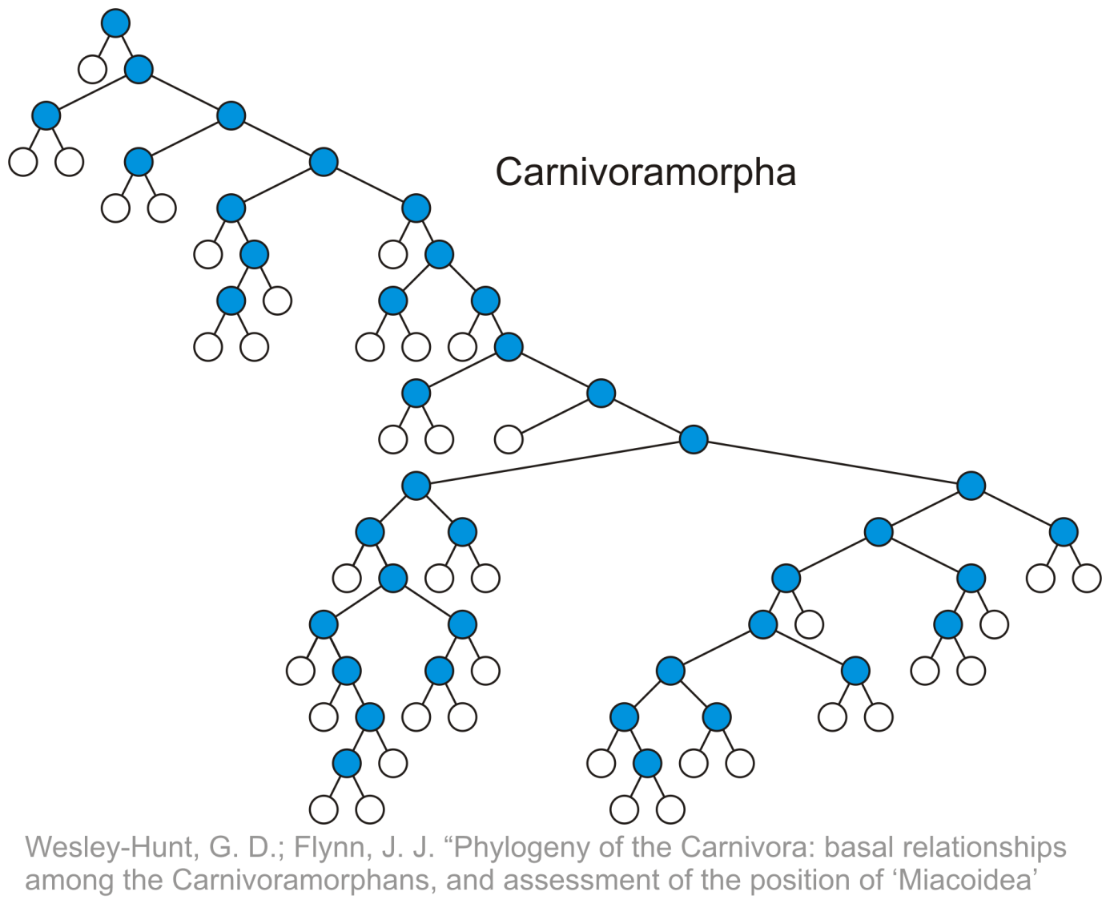
Terminology: Internal Nodes Example
Internal nodes

Slide 11
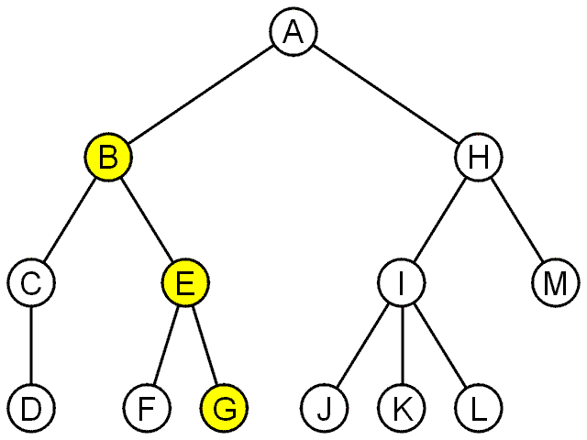
Terminology: Path
A path is a sequence of nodes (a₀, a₁, ..., a_{n})
Where a_{k+1} is a child of a_{k}
The length of this path is n
For example, the path (B, E, G) has length 2

Slide 12
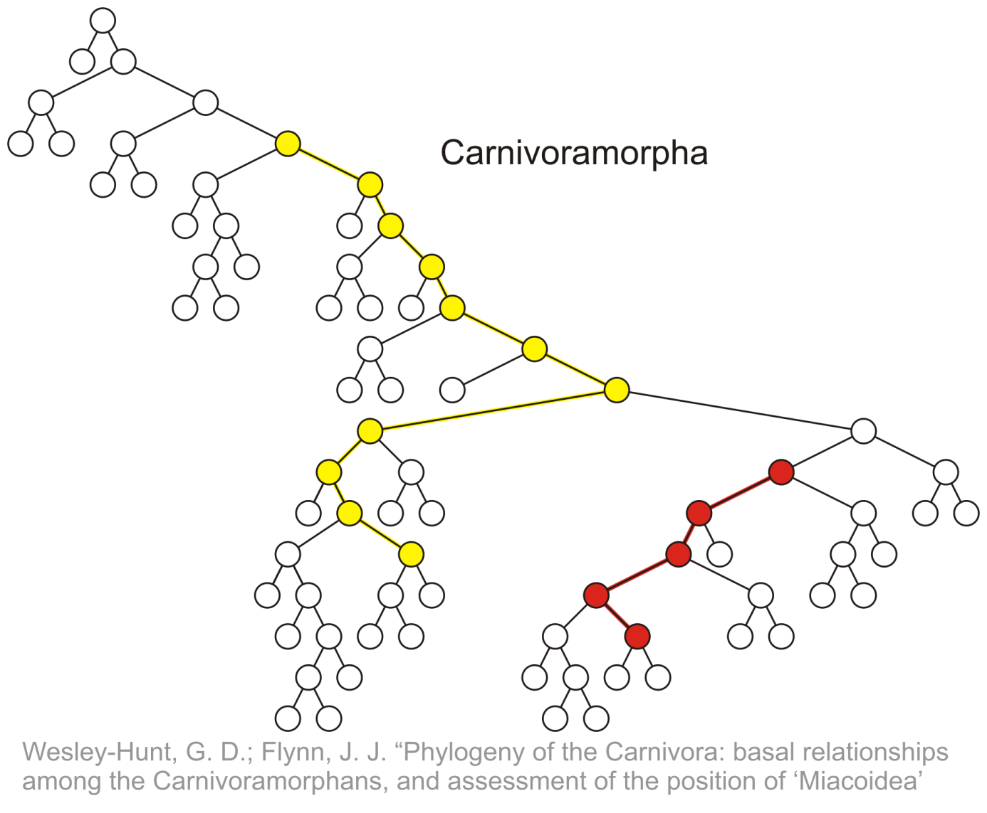
Terminology: Path Example
Paths of length 10 (11 nodes) and 4 (5 nodes)
Start of these paths
End of these paths

Slide 13
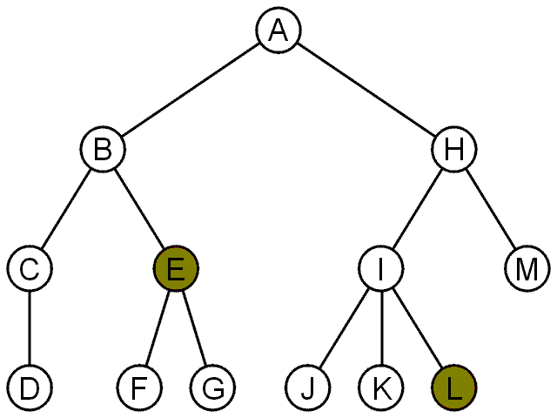
Terminology: Depth (or Level) of a node
For each node in a tree, there exists a unique path from the root node to that node
The length of this path is the depth or level of the node, e.g.,
E has level 2
L has level 3

Slide 14
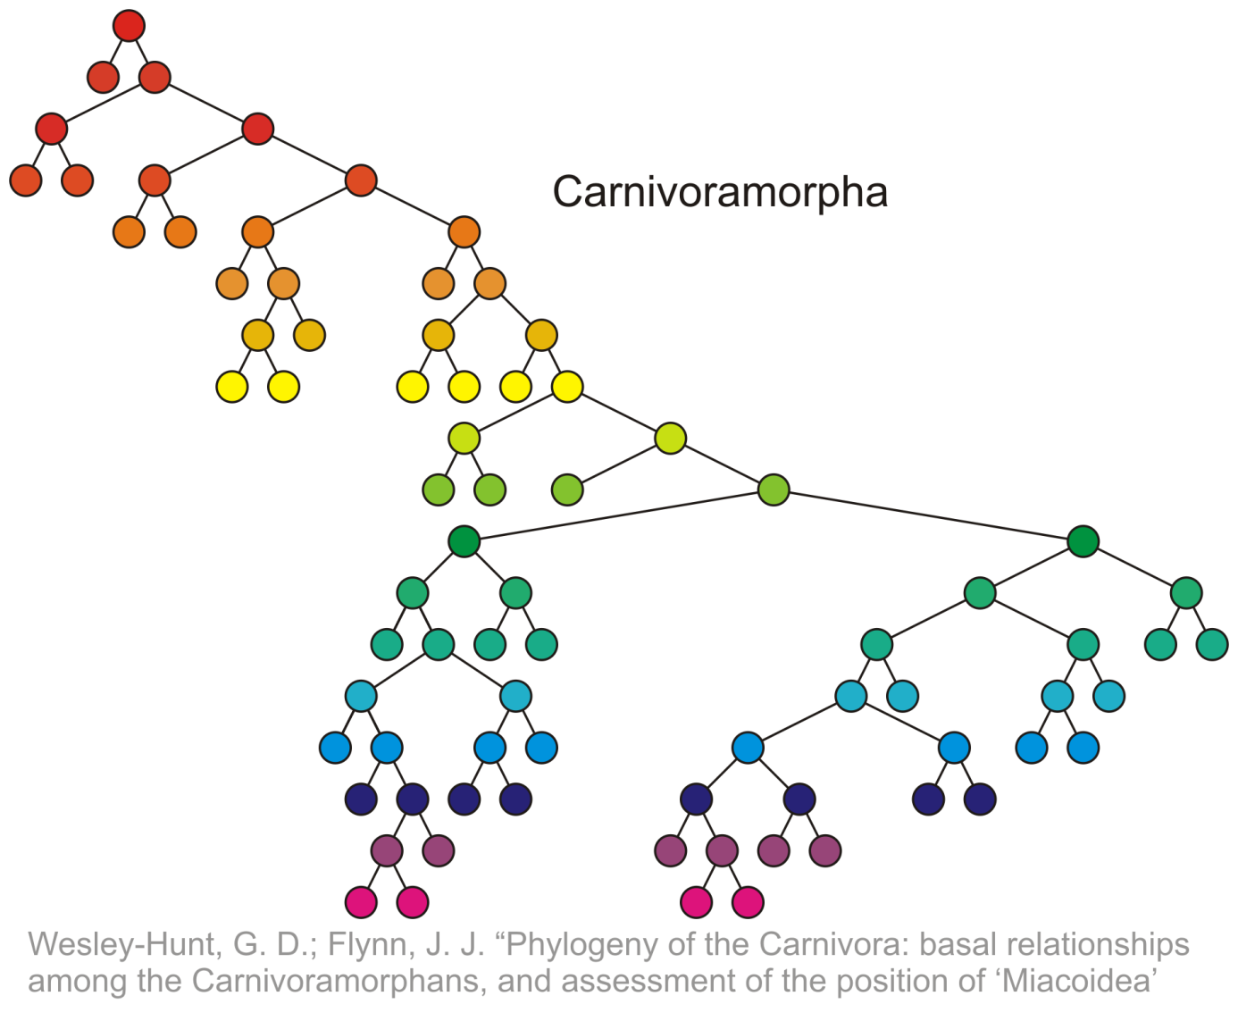
Terminology: Depth Example
Nodes of depth up to 17
0
4
9
14
17

Slide 15
Terminology: Height
The height of a tree is defined as the maximum depth or level of any node within the tree
The height of a tree with one node is 0
Just the root node
For convenience, we define the height of the empty tree to be –1

Slide 16
Terminology: Height Example
Height of this tree is 3
3

Slide 17
Terminology: Ancestors And Descendants
If a path exists from node a to node b
a is an ancestor of b
b is a descendent of a
Thus, a node is both an ancestor and a descendant of itself
We can add the adjective strict to exclude equality
a is a strict descendent of b if a is a descendant of b but a ≠ b
The root node is an ancestor of all nodes

Slide 18
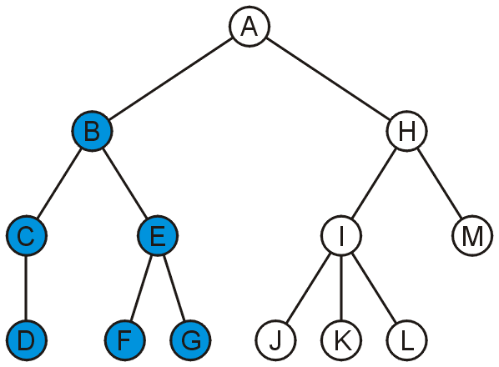
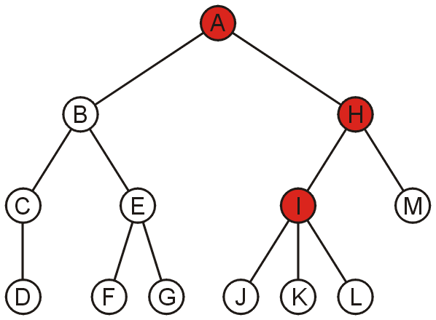
Terminology: Ancestors And Descendants Example
The descendants of node B are C, D, E, F, and G
The ancestors of node I are H and A

Slide 19
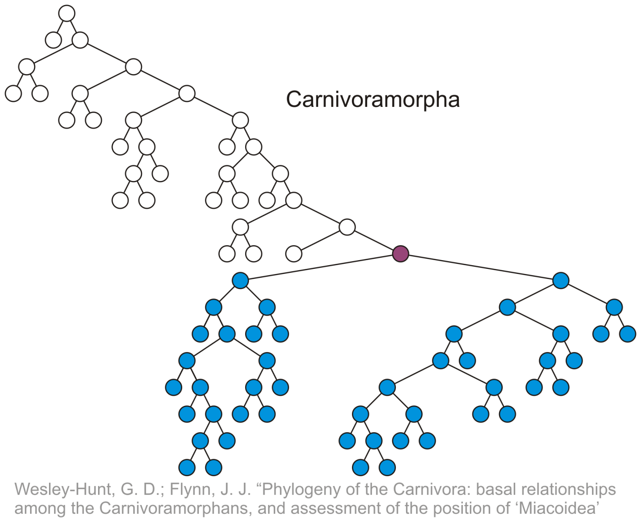
Terminology: Descendants Example
All descendants (including itself) of the indicated node

Slide 20
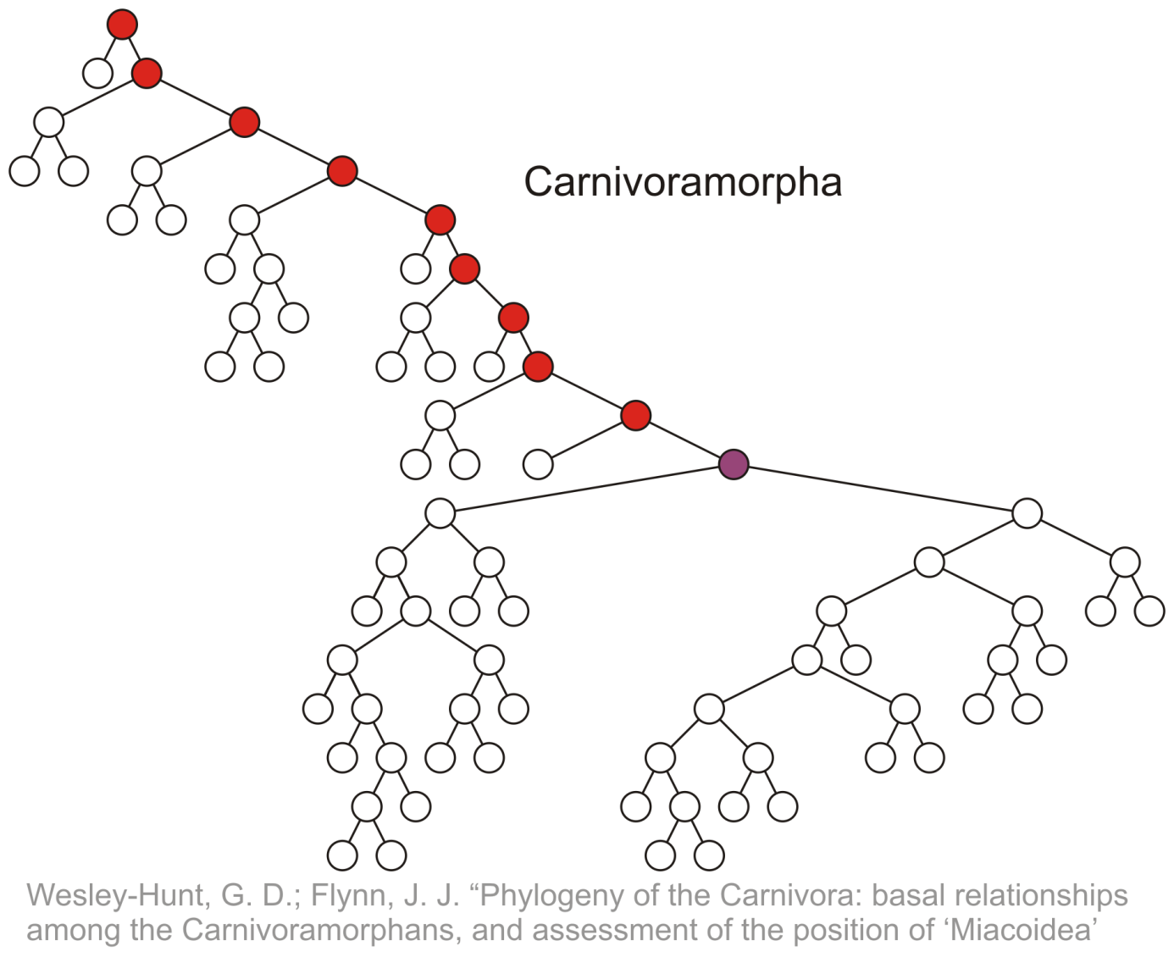
Terminology: Ancestors Example
All ancestors (including itself) of the indicated node

Slide 21
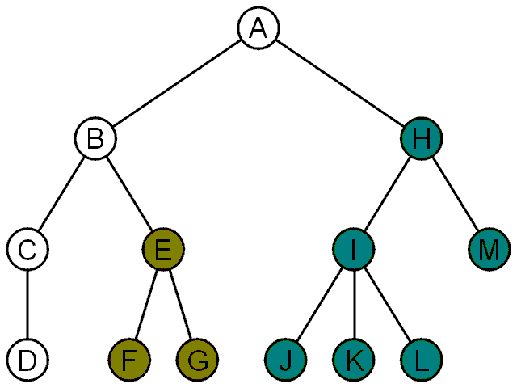
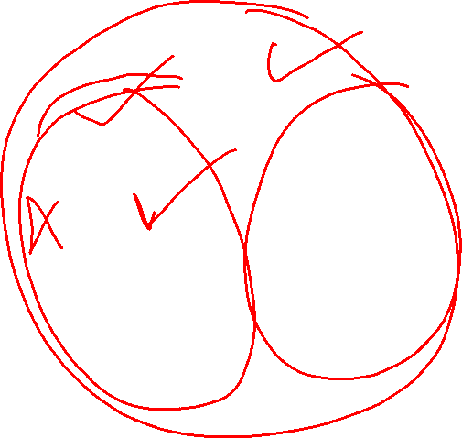
Terminology: Sub-Tree
Another approach to a tree is to define the tree recursively
A degree-0 node is a tree
A node with degree n is a tree if it has n children (here n>1)
All of its children are disjoint trees (i.e., with no intersecting nodes)
Given any node a within a tree with root r, the collection of a and all of its descendants is said to be a subtree of the tree with root a

Slide 22
Tree Properties
A
Property Value
Number of nodes
Height
Root Node
Leaves
Ancestors of H
Descendants of B
Siblings of E
Left subtree
B
C
D
E
F
G
H
I

Slide 23
Example: HTML (1)
HTML document has a tree structure
<html>
<head>
<title>Hello World!</title>
</head>
<body>
<h1>This is a <u>Heading</u></h1>
<p>This is a paragraph with some
<u>underlined</u> text.</p>
</body>
</html>

Slide 24
Example: HTML (2)
HTML document has a tree structure
title
<html>
<head>
<title>Hello World!</title>
</head>
<body>
<h1>This is a <u>Heading</u></h1>
<p>This is a paragraph with some
<u>underlined</u> text.</p>
</body>
</html>
heading
body of page
paragraph
underlining

Slide 25
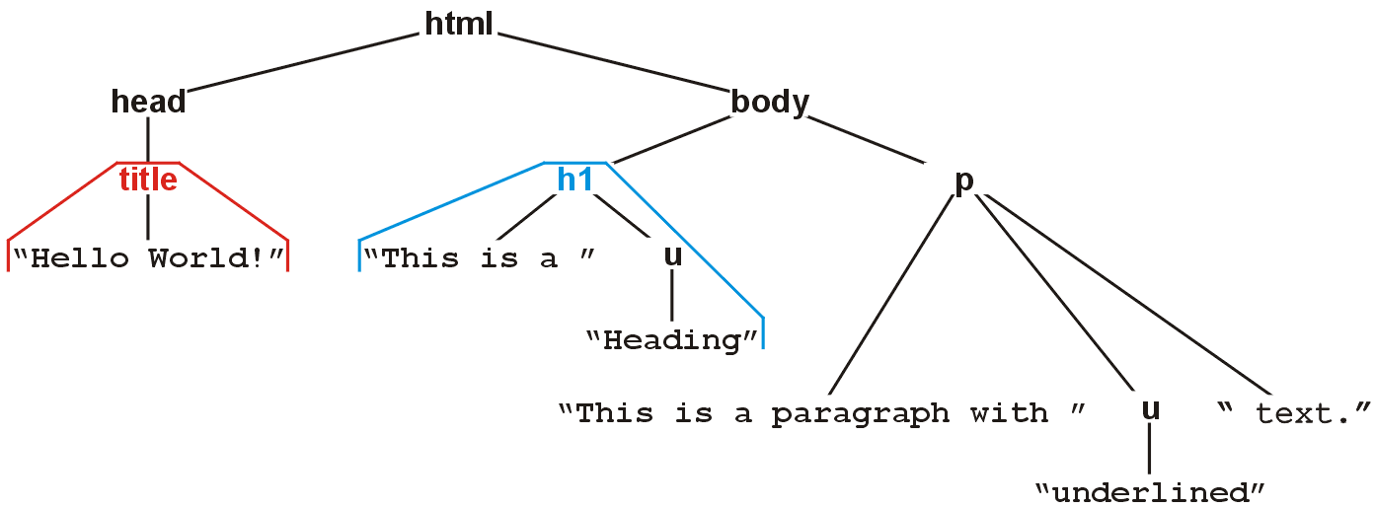
Example: HTML (3)
The nested tags define a tree rooted at the HTML tag
<html>
<head>
<title>Hello World!</title>
</head>
<body>
<h1>This is a <u>Heading</u></h1>
<p>This is a paragraph with some
<u>underlined</u> text.</p>
</body>
</html>

Slide 26
Binary Tree

Slide 27
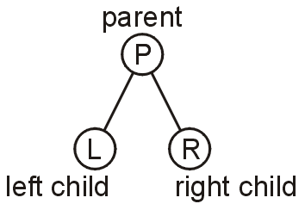
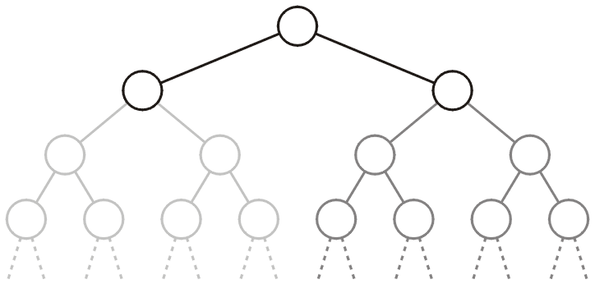
Binary Tree
In a binary tree each node has at most two children
Allows to label the children as left and right
Likewise, the two sub-trees are referred as
Left sub-tree
Right sub-tree

Slide 28
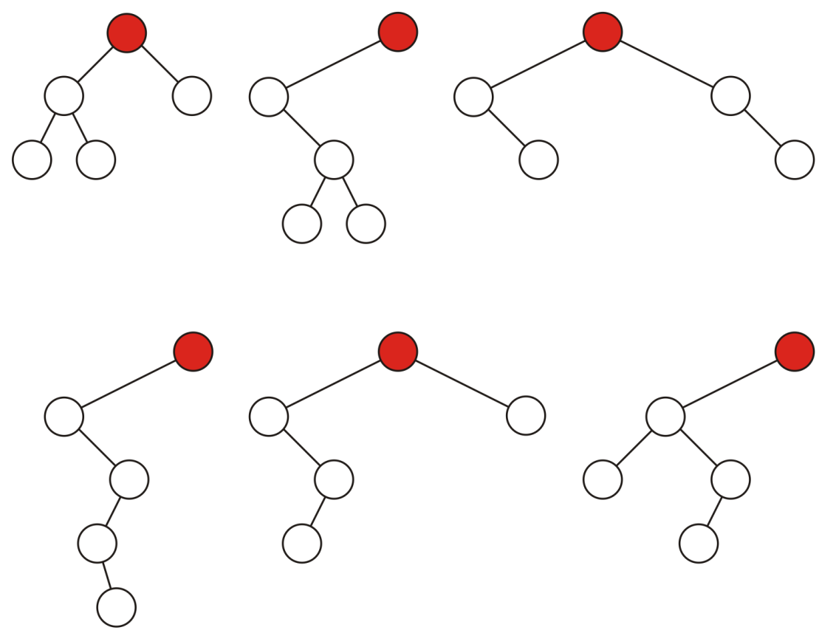
Binary Tree: Example
Some variations on binary trees with five nodes

Slide 29
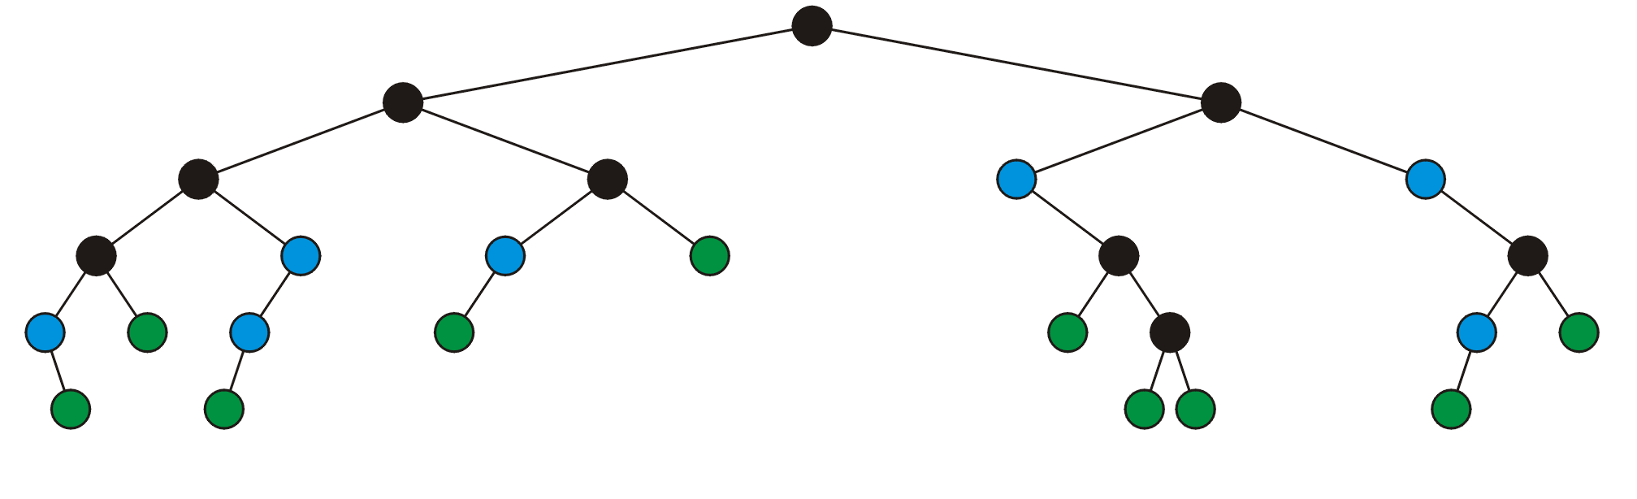
Binary Tree: Full Node
A full node is a node where both the left and right sub-trees are non-empty trees
(OR) if it has exactly two child nodes
full nodes neither leaf nodes

Slide 30
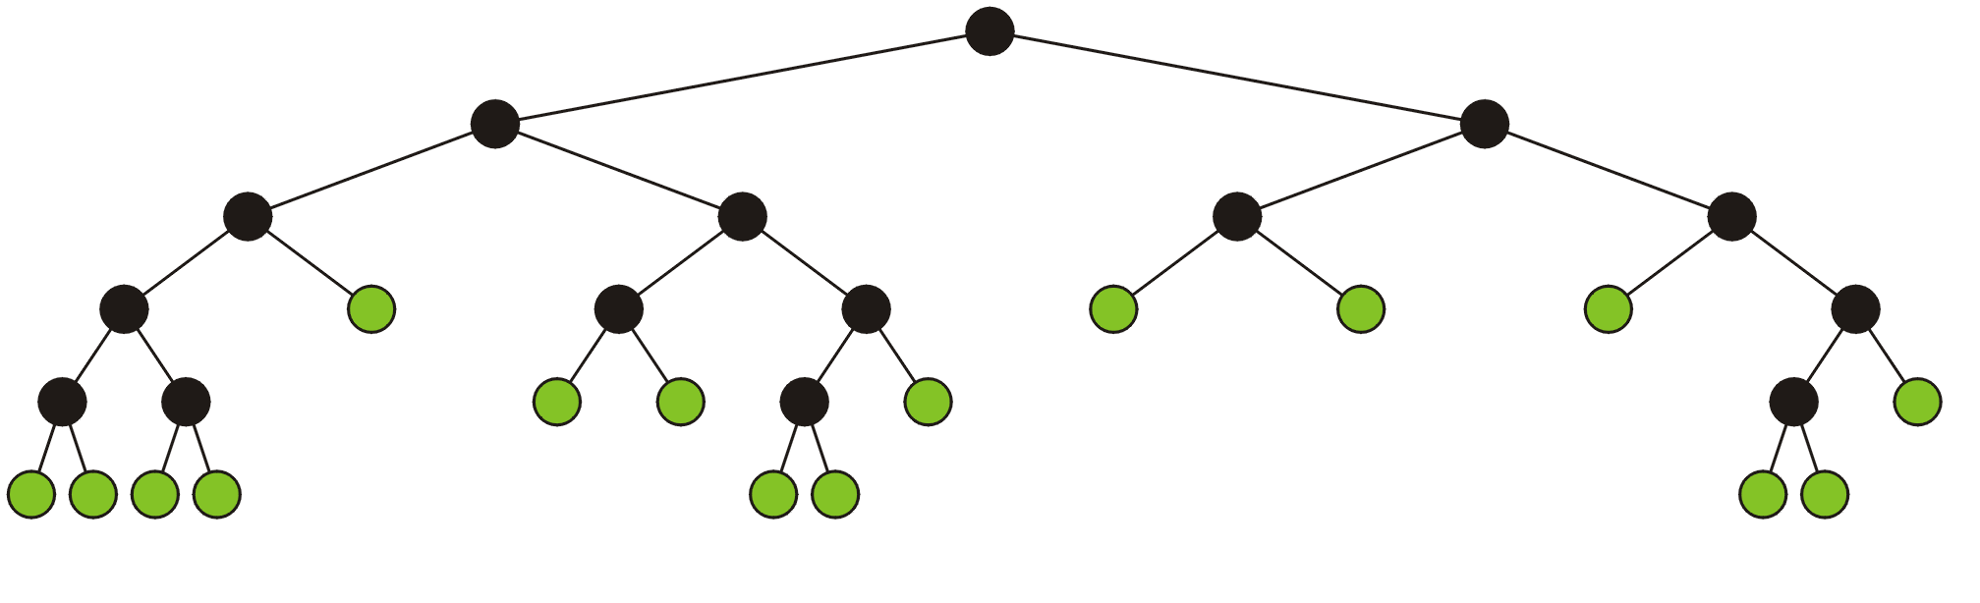
Full Binary Tree
A full binary tree is where each node is:
A full node, or
A leaf node
Full binary tree is also called proper binary tree, strictly binary tree or 2-tree

Slide 31
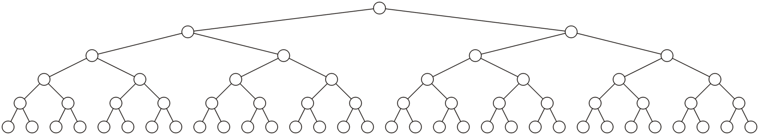
Perfect Binary Tree
A perfect binary tree of height h is a binary tree where:
All leaf nodes have the same depth or level L
All other nodes are full-nodes
Is it a Full binary tree as well?

Slide 32
Perfect Binary Tree: Recursive Definition
A binary tree of height h = 0 is perfect
A binary tree with height h > 0 is perfect
If both sub-trees are prefect binary trees of height h – 1

Slide 33
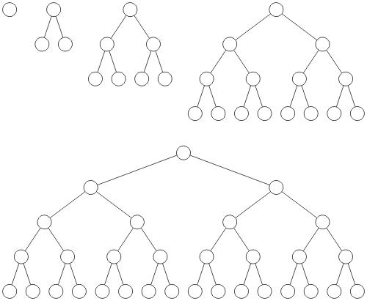
Perfect Binary Tree: Example
Perfect binary trees of height h = 0, 1, 2, 3 and 4
No of leaf nodes? Any relation with the height of the tree?

Slide 34
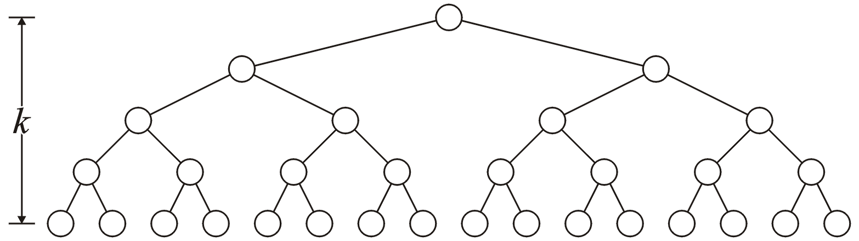
Binary Tree: Properties (1)
A perfect binary tree with height h has 2^{h} leaf nodes
h

Slide 35
Binary Tree: Properties (2)
A perfect binary tree with height h has 2^{h} leaf nodes
A perfect binary tree of height h has 2^{h + 1} – 1 nodes
h

Slide 36
Binary Tree: Properties (3)
A perfect binary tree with height h has 2^{h} leaf nodes
A perfect binary tree of height h has 2^{h + 1} – 1 nodes
Number of leaf nodes: L = 2^{h}
Number of internal nodes: 2^{h} – 1
Total number of nodes: 2L-1 = 2^{h + 1} – 1
h

Slide 37
Binary Tree: Properties (4)
A perfect binary tree with height h has 2^{h} leaf nodes
A perfect binary tree of height h has 2^{h + 1} – 1 nodes
Number of leaf nodes: L = 2^{h}
Number of internal nodes: 2^{h} – 1
Total number of nodes: 2L-1 = 2^{h + 1} – 1
A perfect binary tree with n nodes has height log₂(n + 1) – 1

Slide 38
Binary Tree: Properties (4)
A perfect binary tree with height h has 2^{h} leaf nodes
A perfect binary tree of height h has 2^{h + 1} – 1 nodes
Number of leaf nodes: L = 2^{h}
Number of internal nodes: 2^{h} – 1
Total number of nodes: 2L-1 = 2^{h + 1} – 1
A perfect binary tree with n nodes has height log₂(n + 1) – 1
Number n of nodes in a binary tree of height h is at least h+1 and at most 2^{h + 1} – 1

Slide 39
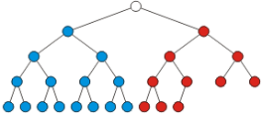
Almost (or Nearly) Complete Binary Tree
Almost complete binary tree of height h is a binary tree in which
There are 2^{d} nodes at depth d for d = 1,2,...,h−1
Each leaf in the tree is either at level h or at level h– 1
The nodes at depth h are as far left as possible
perfect binary tree of height h-1
Missing node towards the right

Slide 40
Almost (or Nearly) Complete Binary Tree
Almost complete binary tree of height h is a binary tree in which
There are 2^{d} nodes at depth d for d = 1,2,...,h−1
Each leaf in the tree is either at level h or at level h– 1
The nodes at depth h are as far left as possible (Formal ?)
Complete binary tree of height h-1
Missing node towards the right

Slide 41
Almost (or Nearly) Complete Binary Tree
Condition 2: The nodes at depth h are as far left as possible
If a node p at depth h−1 has a left child
Every node at depth h−1 to the left of p has 2 children
If a node at depth h−1 has a right child
It also has a left child
Complete binary tree
Not a Complete binary tree
(condition 2 violated)
Notes:
Condition 2 – start filling the nodes from left.

Slide 42
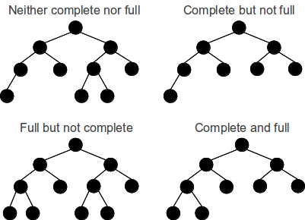
Full vs. Almost Complete Binary Tree

Slide 43
Almost Complete Binary Tree: Properties
Total number of nodes n are between
perfect binary tree of height h-1 + 1(1 in the next level) , i.e., 2^{h} – 1 + 1= 2^{h} nodes
perfect binary tree of height h, i.e., 2^{h+1} -1 nodes
Height h is the largest integer less than or equal to log₂(n)

Slide 44
(Completely) Balanced Binary Tree
Balanced binary tree
For each node, the difference in height of the right and left sub-trees is no more than one
Completely balance binary tree
Left and right sub-trees of every node have the same height

Slide 45
Any Question So Far?

